Slide 1
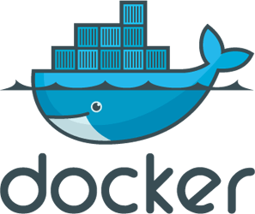
Docker 101
Paula Muldoon
@FiddlersCode
Paul McGrath
@sciphus

Slide 2

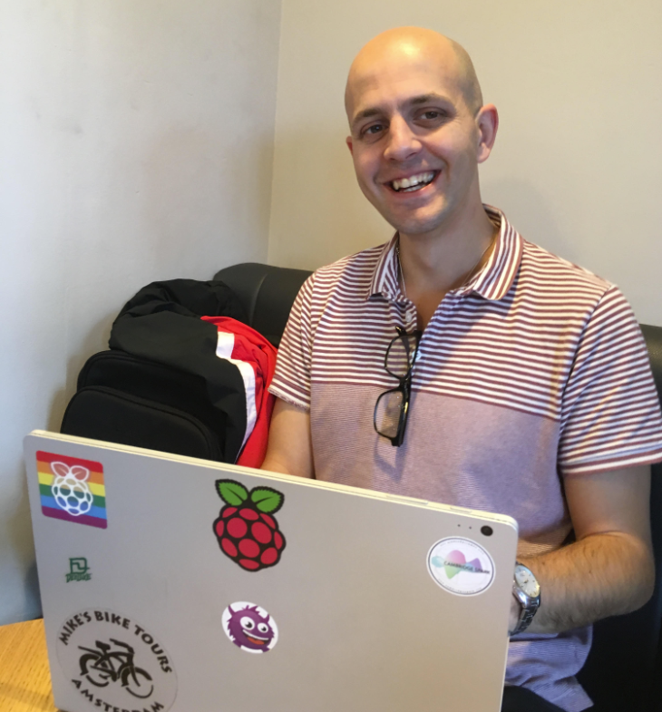
Paula Muldoon
@FiddlersCode
Paul McGrath
@sciphus

Slide 3
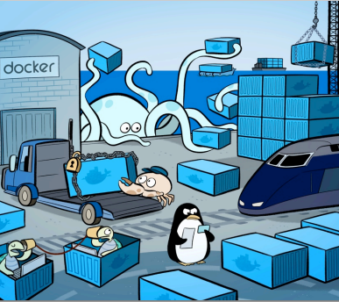
What will we learn today?
Outline of docker and what it can be used for
Build and run an python app
Build and run an app with a database
Use docker to compile .net code and run tests
Not install anything again, ever.
Notes:
Paula

Slide 4

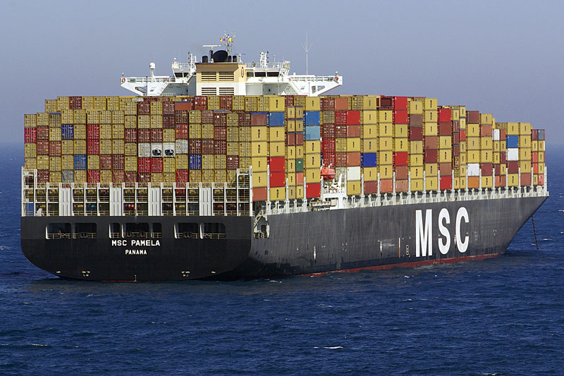
What is Docker?
Shipping container analogy
Build and run, any application, anywhere.
Linux tool
Isolated processes in containers are and old idea
Notes:
Paula

Slide 5
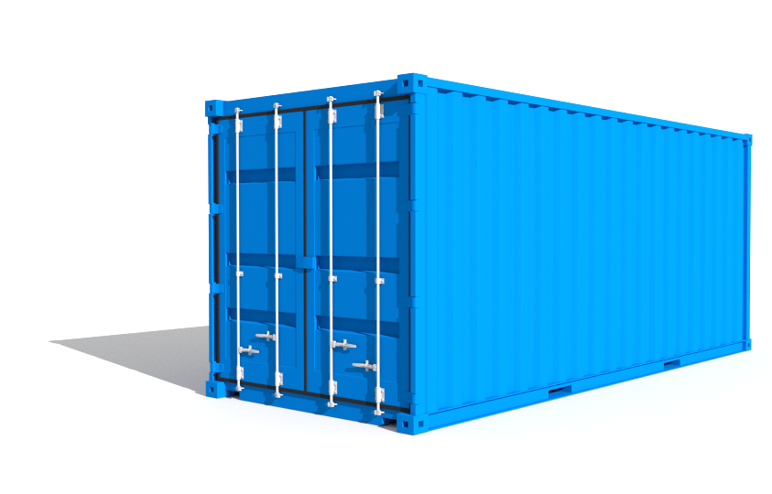
Images and containers
An image is essentially a template.
Created with the docker build command.
Can be built from other images in layers.
A container is a running instance of an image.
Started with the docker run command.
Notes:
Paula
Docker container

Slide 6
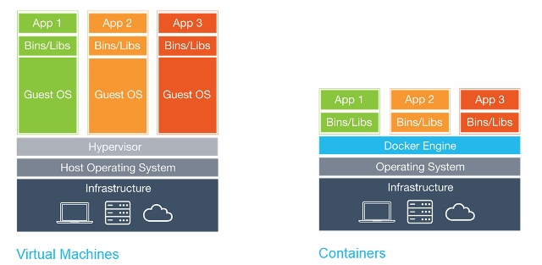
Why not just use a virtual machine?
Containers are isolated but share OS (linux kernel)
Faster startup
Less overhead
Easier migration
Notes:
Paul

Slide 7
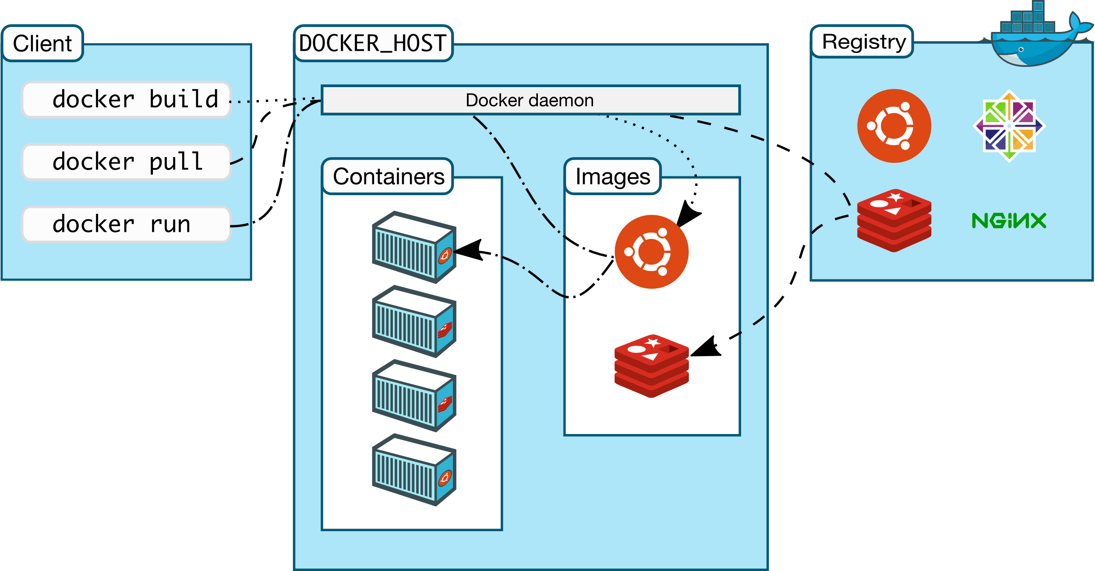
Docker architecture
Use docker version to see details of client/server versions
Notes:
Paul

Slide 8
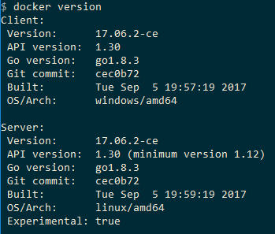

Type docker version at the command prompt
Notes:
Paula

Slide 9

What was in that pre-workshop script?
Image name (alpine linux)
CMD to be run in container
Output from container
i.e. hello from linux docker_host
Notes:
Paula
The pre workshop script downloaded all the docker images that we’re going to use in this workshop (so that we don’t need to download the internet 400mb).

Slide 10
Let’s try another
docker run –d –p 5959:80 dockersamples/static-site
If you’re using docker toolbox:
Run docker machine ip default to get the DOCKER_HOST ip address
Then visit localhost:5959/ in your browser
Notes:
Paula

Slide 11
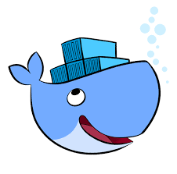
How was that created?
A “Dockerfile” describes an image
Image is built by running docker build .
FROM nginx
ADD html /usr/share/nginx/html
EXPOSE 80
Notes:
Paula

Slide 12

The Dockerfile
FROM – The base image to use e.g. nginx
RUN – A linux command to run when building
EXPOSE – Specify ports that are used at run time
ADD – Copy files from your system into the container
CMD – Command to run that can be overridden as part of docker run
CMD ["executable","param1","param2"]
Notes:
Paula

Slide 13
Build your own image…
Cd to the folder where you cloned the git repo github.com/pavlosmcg/docker101
In first-container directory
Create this “Dockerfile”
Run docker build . –t my-app
FROM python:3.4-alpine
ADD . /code
WORKDIR /code
RUN pip install -r requirements.txt
EXPOSE 5000
CMD ["python", "app.py"]
Notes:
Paula

Slide 14
…and run your own container
docker run –d –p 5858:5000 my-app
Then visit localhost:5858/ in your browser

Slide 15

General investigation tips
docker ps -- shows running containers
docker ps –a -- also shows stopped containers
docker images -- shows all available images
docker logs <container id> -- shows stdout from container
Notes:
PAUL FROM HERE
docker run –it alpine
docker exec -i -t 665b4a1e17b6 /bin/bash
docker run –it alpine
docker exec -it e72928639a2a ls /bin
docker exec -it e72928639a2a /bin/sh

Slide 16
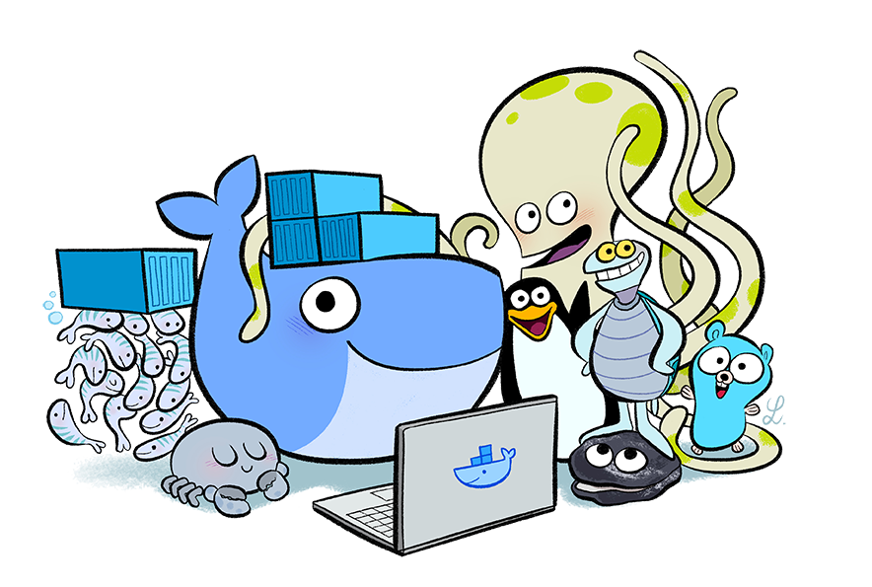
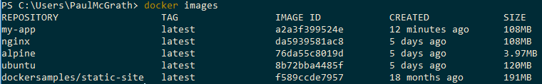
Take a look at your docker host
docker images
docker ps
docker ps -a

Slide 17
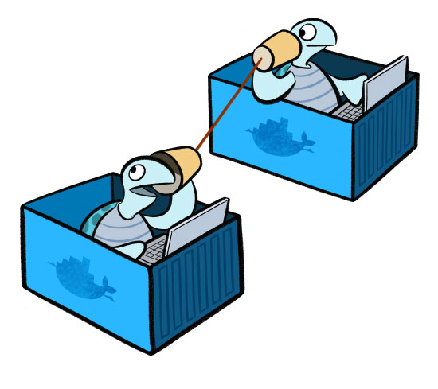


Communicating between containers
A project is usually more than a web layer
You may want to scale UI or backend independently
Introducing docker-compose

Slide 18
Create a docker-compose file…
Create docker-compose/docker-compose.yml:
version: '3'
services:
web:
build: .
ports:
- “4545:5000"
redis:
image: "redis:alpine"

Slide 19
…and run your two communicating containers
docker-compose build
docker-compose up -d
Then visit localhost:4545/ in your browser

Slide 20
Compiling .NET code with docker
docker run --rm --volume "$(pwd):/build" --workdir /build mono ./build.sh
Running unit tests
docker run --rm --volume "$(pwd):/build" --workdir /build mono ./test.sh

Slide 21
Try building my C# project without .net installed
In the build-and-test directory
docker run --rm --volume "$(pwd):/build" --workdir /build mono ./build.sh
docker run --rm --volume "$(pwd):/build" --workdir /build mono ./tests.sh

Slide 22

Cleaning up
Stop containers: docker stop <id or name>
docker-compose stop
Remove stopped containers: docker rm <id or name>
Remove images: docker rmi <id or name>
Remove volumes: docker volume rm <volume name>
Notes:
Paula? You were asking about this
Stop all containers: docker stop $(docker ps –a –q)
Remove all containers: docker rm $(docker ps –a –q)
Remove dangling images: docker rmi $(docker images -f dangling=true -q)
Remove dangling images: docker volume rm $(docker volume ls -f dangling=true -q)
docker system prune
To additionally remove any stopped containers and all unused images (not just dangling images), add the -a flag to the command:
docker system prune -a

Slide 23
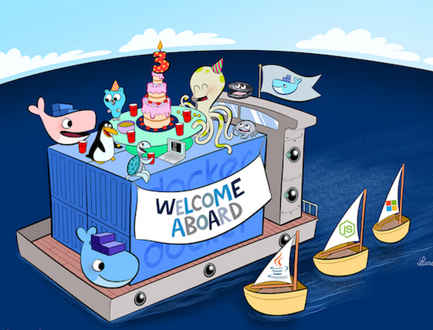

THANK YOU
Paul & Paula
@FiddlersCode
@sciphus

